Slide 1

KLEHB-FED-26-10-8 - Clinic Appointment & Prescription Manager
A Java-based system for managing appointments, prescriptions, and patient history.
TEAM MEMBERS
2620030354 – Sujan
2620030636 – Chandra Paul

Slide 2

Problem Statement
Appointment clashes and double booking
Patient uncertainty about doctor availability
Difficulty maintaining prescription records
Manual management leads to errors and data loss
Need for a simple computerized clinic management system

Slide 3
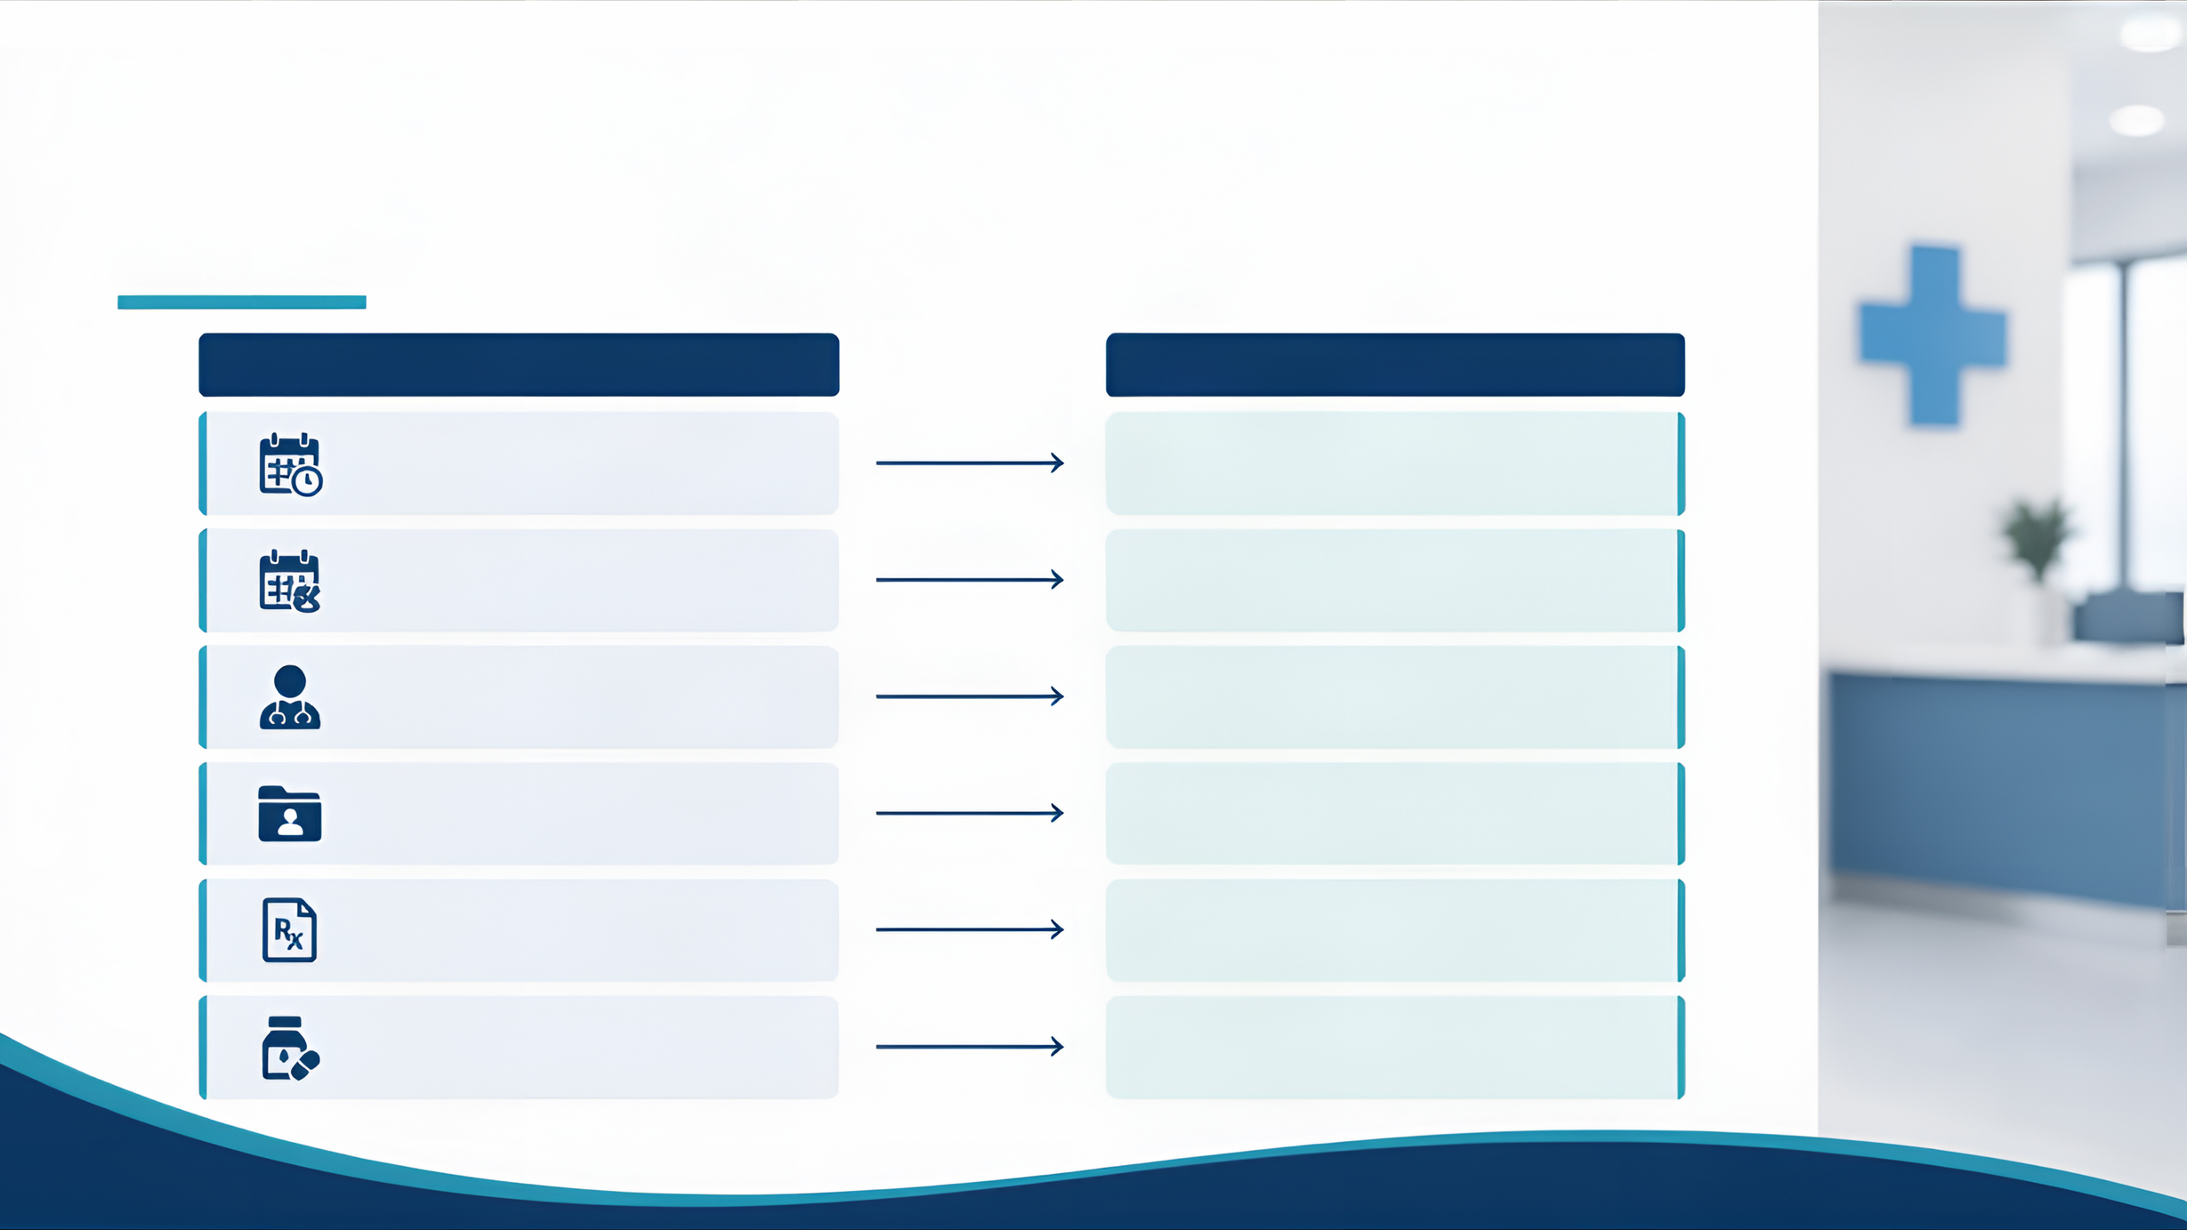
Existing Problems & Need for the System
CURRENT CHALLENGES
IMPACT ON CLINIC & PATIENTS
Manual appointment booking
Low efficiency, risk of errors
Appointment conflicts
Patient dissatisfaction, lost time
Difficulty checking doctor availability
Scheduling delays
Difficulty maintaining patient history
Incomplete records
Prescription records lost or hard to retrieve
Risk to patient safety
No automatic medicine interaction warnings
Potential harmful drug combinations

Slide 4
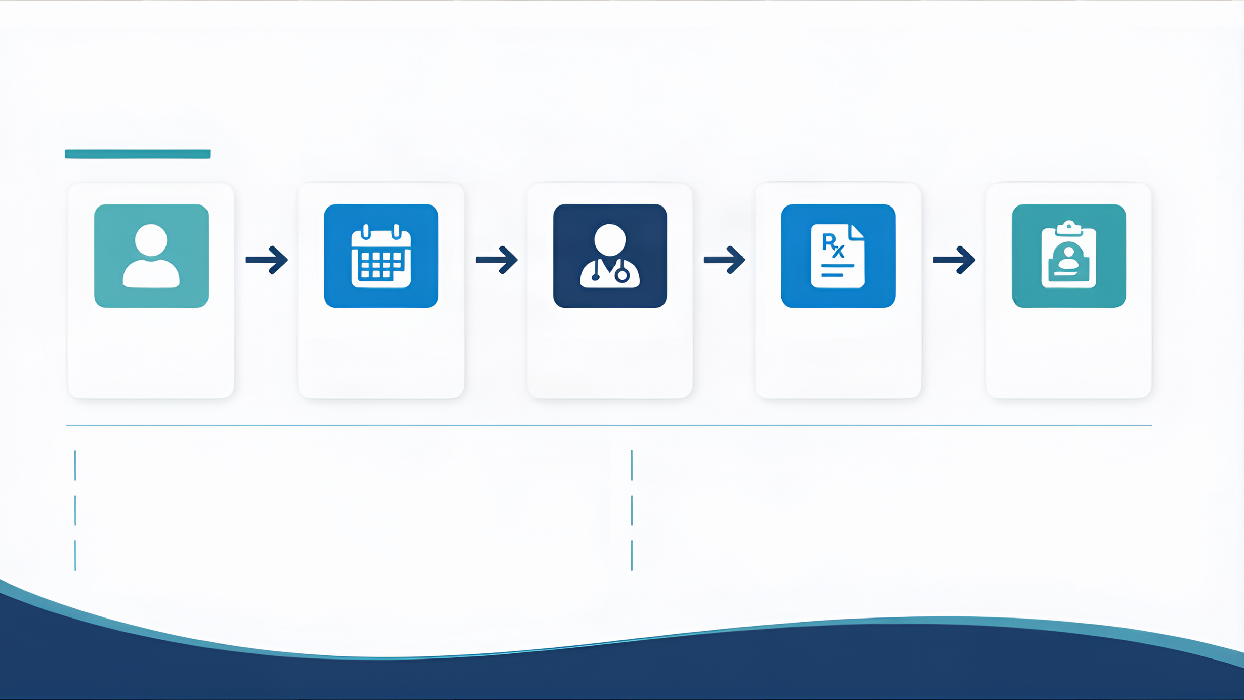
Proposed Solution / Approach
Patient
Appointment Management
Doctor Schedule
Prescription Management
Patient History
Digital schedules prevent overlapping appointments
Secure storage of patient and prescription data
Real-time availability checks before booking
Quick access to patient history on demand
Simple rescheduling for greater flexibility
Basic medicine interaction warnings included

Slide 5

Technologies & Techniques Used
Java programming language
Robust, reliable, and platform-independent
Console-based menu system
Simple and user-friendly interface
Core concepts
Classes, objects, methods, collections, conditionals and loops
Smart logic and validation
Input validation, searching, schedule conflict detection
Prescription safety checks
Detects medicine interactions and issues warnings

Slide 6
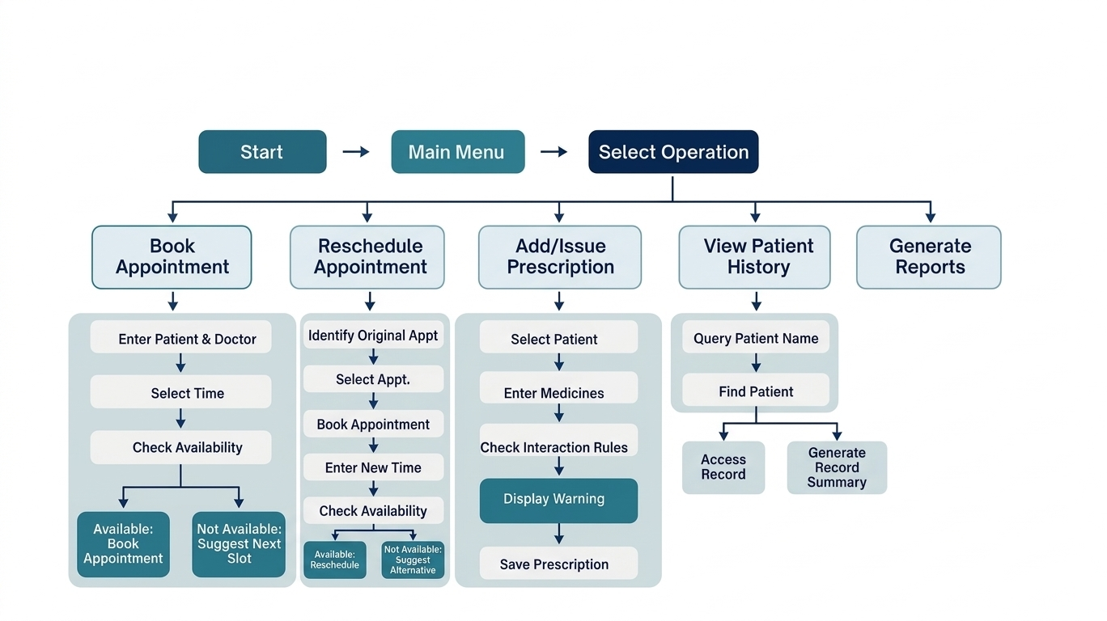

Slide 7
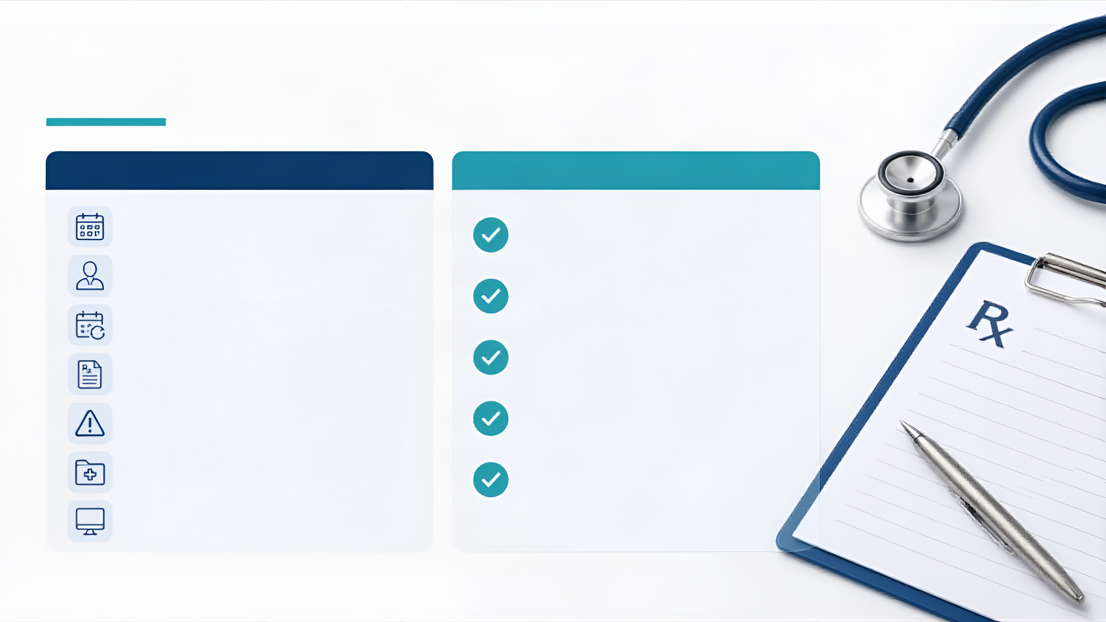
Key Features & Expected Results
KEY FEATURES
EXPECTED RESULTS
Clash-free appointment booking
Reduced appointment conflicts
Doctor availability management
Easier doctor availability checks
Appointment rescheduling
Organized prescription records
Prescription management
Medicine interaction warning
Improved patient info retrieval
Patient history management
Basic safety warnings for medicine combinations
Simple menu-driven interface

Slide 8

Conclusion
Provides a simple computerized solution to common clinic management problems
Integrates appointment scheduling, doctor availability, prescription management, interaction checking, and patient history
Demonstrates practical application of Java programming concepts to real-world healthcare challenges
THANK YOU
Questions?

